Slide 1
BASIC SQL
Lecture 15

Slide 2

BASIC SQL
  Structured Query Language
  Statements for data definitions, queries, and updates (both DDL and DML)
  Each statement in SQL ends with a semicolon

Slide 3

WHAT CAN BE DONE USING SQL
execute queries on a database
retrieve data from a database
insert records in a database
update records in a database
delete records from a database
create new databases
create new tables in a database
create stored procedures in a database
create views in a database
set permissions on tables, procedures, and views

Slide 4
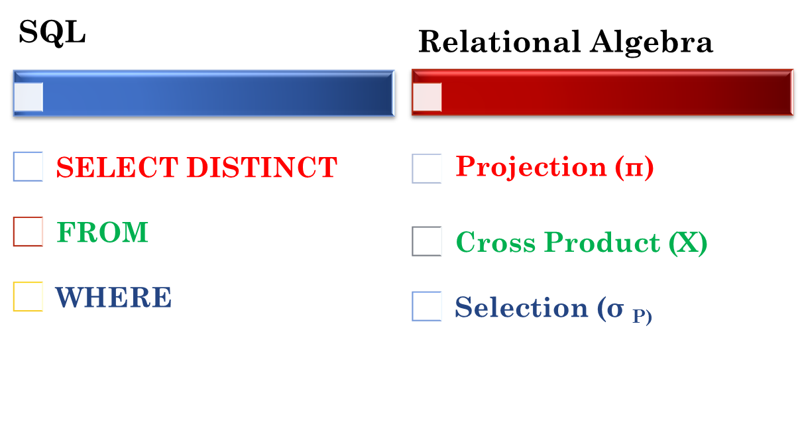
RELATIONAL ALGEBRA VS SQL
        SELECT DISTINCT A1, A2, …… An
        FROM R1, R2, …. Rn
        WHERE P
========================
π _{A1, A2, ...... An} (σ _{P} ( R1 x R2 x ……….. x Rn)

Slide 5
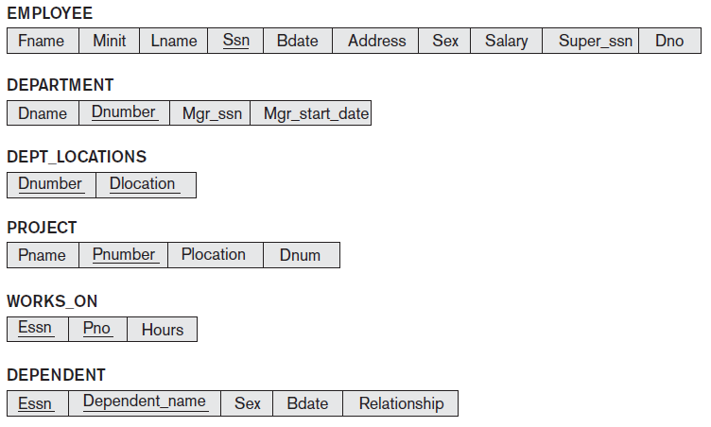
COMPANY DATABASE

Slide 6
CREATE TABLE COMMAND
To create a new table in a database.
Specify each attributes and their data types (eg. INTEGER, FLOAT, DECIMAL(i,j), CHAR(n), VARCHAR(n))
Syntax:
  CREATE TABLE table_name (
  column1 datatype,
  column2 datatype,
  column3 datatype,
  ....
  );

Slide 7
CREATE TABLE COMMAND
A constraint NOT NULL may be specified on an attribute
Can specify the primary key attributes, secondary keys and referential integrity constraints (foreign keys).
  CREATE TABLE DEPT
  ( DNAME VARCHAR(10) NOT NULL,
  DNUMBER INTEGER NOT NULL,
  MGRSSN CHAR(9),
  MGRSTARTDATE CHAR(9),
  PRIMARY KEY (DNUMBER),
  UNIQUE (DNAME),
  FOREIGN KEY (MGRSSN) REFERENCES EMP );

Slide 8
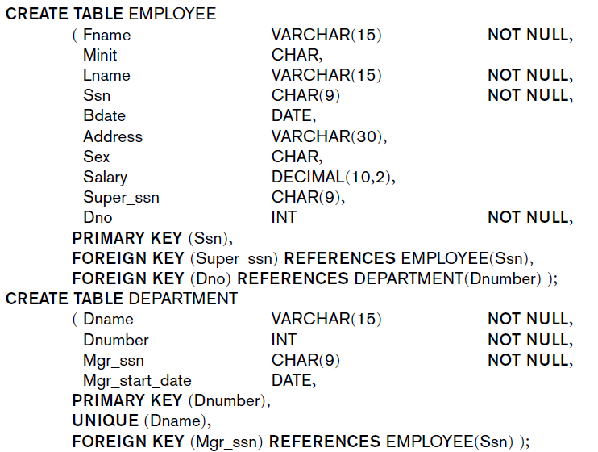
CREATE TABLE COMMAND EXAMPLE

Slide 9
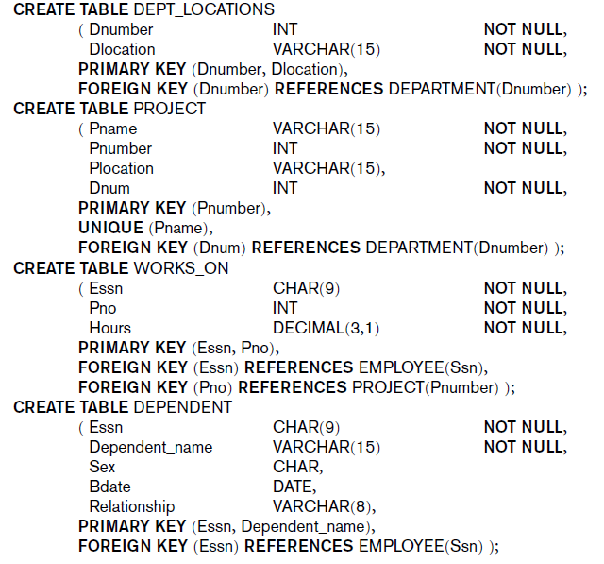
CREATE TABLE COMMAND EXAMPLE

Slide 10
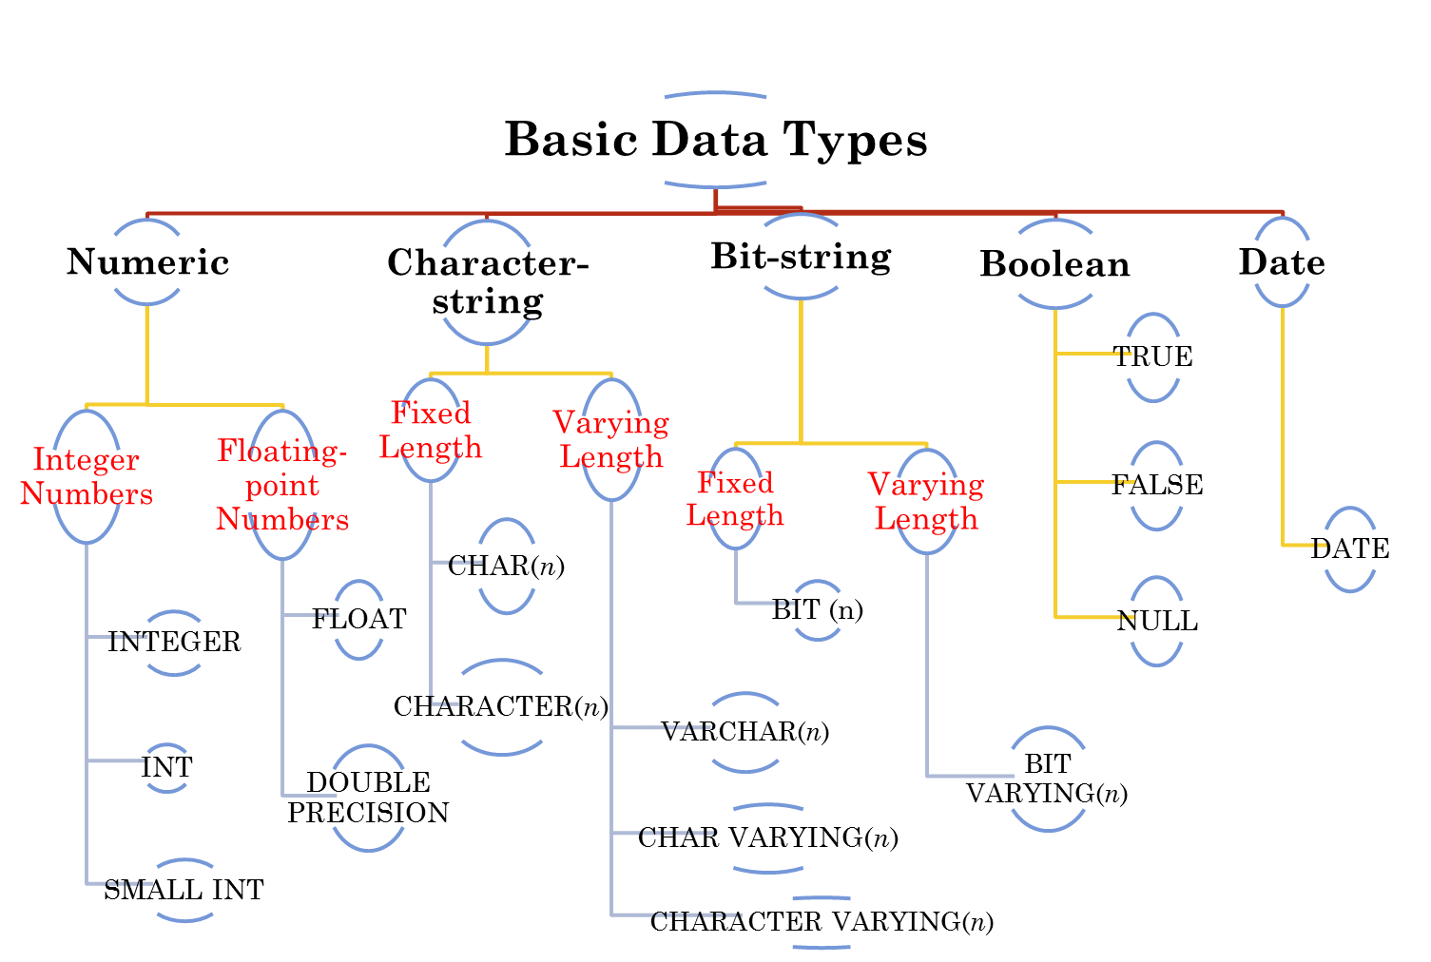
ATTRIBUTE DATA TYPES AND DOMAINS
or
YYYY-MM-DD
or
or

Slide 11
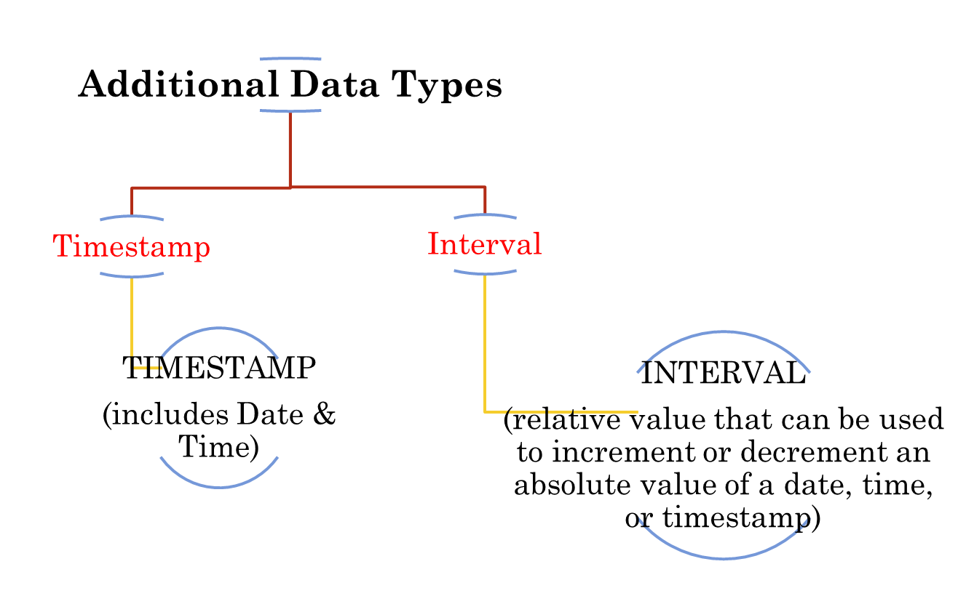
ATTRIBUTE DATA TYPES AND DOMAINS

Slide 12
ATTRIBUTE DATA TYPES AND DOMAINS
Domain
  Name used with the attribute specification
  Makes it easier to change the data type for a domain that is used by numerous attributes
  Improves schema readability
  Example:
    CREATE DOMAIN SSN_TYPE AS CHAR(9);
use SSN_TYPE in place of CHAR(9)

Slide 13
SPECIFYING ATTRIBUTE CONSTRAINTS & ATTRIBUTE DEFAULTS
NULL is not permitted for DNAME
  CREATE TABLE DEPT
  ( DNAME VARCHAR(10) NOT NULL,
  MGRSSN CHAR(9) DEFAULT ‘N.A.’,
  MGRSTARTDATE CHAR(9),
  UNIQUE (DNAME),
  DNUMBER INT NOT NULL CHECK(DNUMBER > 0 AND DNUMBER < 21);
  PRIMARY KEY (DNUMBER),
  FOREIGN KEY (MGRSSN) REFERENCES EMP );
Set Default value for MGRSSN
Limit the value range of DNUMBER

Slide 14
SPECIFYING CONSTRAINTS ON TUPLES USING CHECK
  CREATE TABLE DEPT
  ( DNAME VARCHAR(10) NOT NULL,
  MGRSSN CHAR(9) DEFAULT ‘N.A.’,
  MGRSTARTDATE DATE,
  UNIQUE (DNAME),
  DNUMBER INT NOT NULL,
  D_CREATE_DATE DATE,
  PRIMARY KEY (DNUMBER),
  FOREIGN KEY (MGRSSN) REFERENCES EMP,
  CHECK (D_CREATE_DATE <= MGRSTARTDATE);
  );
  Specified at the end of CREATE TABLE command
  Apply to each tuple individually

Slide 15
SPECIFYING KEY AND REFERENTIAL INTEGRITY CONSTRAINTS
CREATE TABLE DEPARTMENT
  ( Dname VARCHAR(15) NOT NULL,
  Dnumber INT NOT NULL,
  Mgr_ssn CHAR(9) NOT NULL,
  Mgr_start_date DATE,
  PRIMARY KEY (Dnumber),
  UNIQUE (Dname),
  FOREIGN KEY (Mgr_ssn) REFERENCES EMPLOYEE(Ssn) );
To specify Dnumber is a Primary Key
To specify Dname is an alternate/secondary key

Slide 16
SPECIFYING KEY AND REFERENTIAL INTEGRITY CONSTRAINTS (CONT.)
CREATE TABLE DEPT_LOCATIONS
  ( Dnumber INT NOT NULL,
  Dlocation VARCHAR(15) NOT NULL,
  PRIMARY KEY (Dnumber, Dlocation),
  FOREIGN KEY (Dnumber) REFERENCES DEPARTMENT (Dnumber) ON DELETE CASCADE ON UPDATE CASCADE);
It implies Dnumber of DEPT_LOCATIONS table is referencing Dnumber of DEPARTMENT table
If a value is deleted/updated in Dnumber of DEPARTMENT table, what action is to be taken for Dnumber of DEPT_LOCATIONS table.
    Options include SET NULL, CASCADE, and SET DEFAULT

Slide 17
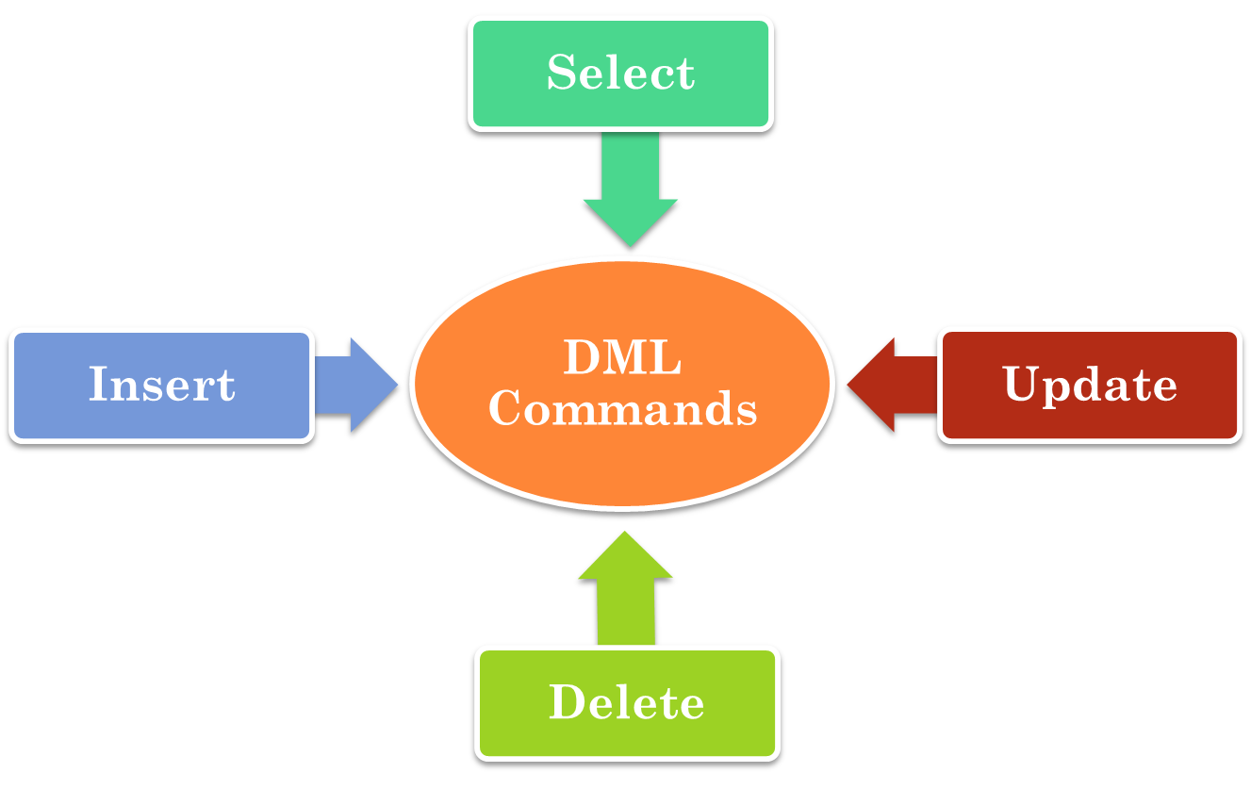
DML COMMANDS

Slide 18
THE INSERT COMMAND
CREATE TABLE EMPLOYEE
    ( Fname VARCHAR(15) NOT NULL,
    Minit CHAR,
    Lname VARCHAR(15) NOT NULL,
    Ssn CHAR(9) NOT NULL,
    Bdate DATE,
    Address VARCHAR(30),
    Sex CHAR,
    Salary DECIMAL(10,2),
    Super_ssn CHAR(9),
    Dno INT NOT NULL,
    PRIMARY KEY (Ssn),
    FOREIGN KEY (Super_ssn) REFERENCES EMPLOYEE(Ssn),
    FOREIGN KEY (Dno) REFERENCES DEPARTMENT(Dnumber) );
INSERT INTO EMPLOYEE VALUES ( ‘Richard’, ‘K’, ‘Marini’, ‘653298653’, ‘1962-12-30’, ‘98 Oak Forest, Katy, TX’, ‘M’, 37000, ‘653298653’, 4 );
Creating new table in database
Inserting entries in EMPLOYEE table

Slide 19
INSERT COMMAND (CONT.)
INSERT INTO EMPLOYEE (Fname, Lname, Dno, Ssn)
VALUES (‘Richard’, ‘Marini’, 4, ‘653298653’);
INSERT INTO EMPLOYEE (Fname, Lname, Ssn, Dno)
VALUES (‘Robert’, ‘Hatcher’, ‘980760540’, 2);
INSERT INTO EMPLOYEE (Fname, Lname, Dno)
VALUES (‘Robert’, ‘Hatcher’, 5);
values must include all attributes with NOT NULL specification and no default value.
rejected as EMPLOYEE Dno is foreign key of DEPARTMENT table and there is no department 2
rejected as Ssn is defined NOT NULL

Slide 20
BASIC RETRIEVAL QUERIES - SELECT
Dname | Dnumber | Dlocation
Headquarters | 1 | Houston
Administration | 4 | Stafford
Research | 5 | Bellaire
Research | 5 | Sugarland
Administration | 4 | Stafford
Research | 5 | Houston
Two or more tuples that are identical in all their attribute values are allowed in SQL

Slide 21
SELECT-FROM-WHERE STRUCTURE
  SELECT <attribute list>
  FROM <table list>
  WHERE <condition>;
<attribute list> is a list of attribute names whose values are to be retrieved by the query.
<table list> is a list of the relation names required to process the query.
<condition> is a conditional (Boolean) expression that identifies the tuples to be retrieved by the query.

Slide 22

EXAMPLE
Query: Retrieve the birth date and address of the employee(s) whose name is ‘John B. Smith’.
    SELECT Bdate, Address
    FROM EMPLOYEE
    WHERE Fname= ‘John’ AND Minit =‘B’ AND Lname =‘Smith’;
Output:

Slide 23
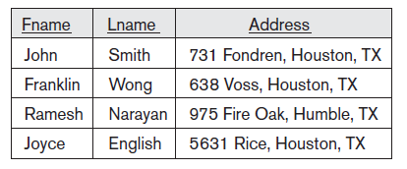
EXAMPLE
Query: Retrieve the name and address of all employees who work for the ‘Research’ department.
        SELECT Fname, Lname, Address
        FROM EMPLOYEE, DEPARTMENT
        WHERE Dname = ‘Research’ AND Dnumber = Dno;
Output:

Slide 24
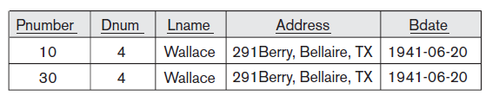
EXAMPLE
Query: For every project located in ‘Stafford’, list the project number, the controlling department number, and the department manager’s last name, address, and birth date.
    SELECT Pnumber, Dnum, Lname, Address, Bdate
    FROM PROJECT, DEPARTMENT, EMPLOYEE
    WHERE Dnum = Dnumber AND Mgr_ssn = Ssn AND
    Plocation=‘Stafford’;
Output:

Slide 25
AMBIGUOUS ATTRIBUTE NAMES
Same name can be used for two (or more) attributes as long as the attributes are in different relations
    SELECT Fname, EMPLOYEE.Name, Address
    FROM EMPLOYEE, DEPARTMENT
    WHERE DEPARTMENT.Name = ‘Research’ AND
    DEPARTMENT.Dnumber = EMPLOYEE.Dnumber;
Specify table name along with attribute name whenever two tables have same attribute names

Slide 26
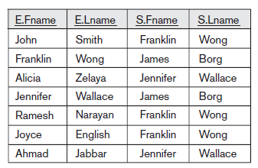
ALIASING, RENAMING AND TUPLE VARIABLES
Query: For each employee, retrieve the employee’s first and last name and the first and last name of his or her immediate supervisor.
    SELECT E.Fname, E.Lname, S.Fname, S.Lname
    FROM EMPLOYEE AS E, EMPLOYEE AS S
    WHERE E.Super_ssn = S.Ssn;
Output:
Aliasing table names.
Table & Attribute Aliasing: EMPLOYEE AS E (Fn, Mi, Ln, Ssn, Bd, Addr, Sex, Sal, Sssn, Dno)

Slide 27
UNSPECIFIED WHERE CLAUSE
Query: Select all EMPLOYEE Ssns
      SELECT Ssn
      FROM EMPLOYEE;
Output:
no condition on tuple selection
Ssn
123456789
333445555
999887777
453453453
666884444
987654321
987987987
888665555

Slide 28
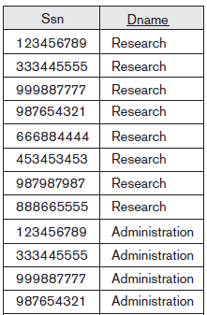
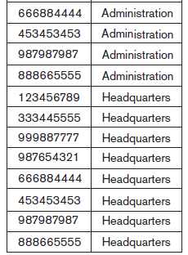
UNSPECIFIED WHERE CLAUSE (CONT.)
Query: Select all combinations of EMPLOYEE Ssn and DEPARTMENT Dname in the database.
      SELECT Ssn, Dname
      FROM EMPLOYEE, DEPARTMENT;
Output:
CROSS PRODUCT - All possible tuple combinations

Slide 29
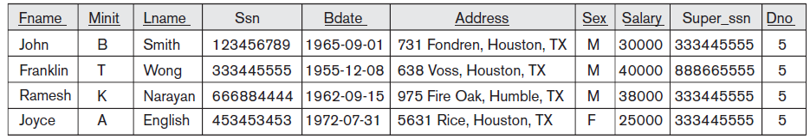
USE OF THE ASTERISK
Query: Retrieve all the attribute values of any EMPLOYEE who works in DEPARTMENT number 5
      SELECT *
      FROM EMPLOYEE
      WHERE Dno=5;
Output:
Retrieve all the attribute values of the selected tuples

Slide 30
WHAT IS OUTPUT?
Query 1:
  SELECT *
  FROM EMPLOYEE, DEPARTMENT
  WHERE Dname = ‘Research’ AND Dno = Dnumber;
Query 2:
  SELECT *
  FROM EMPLOYEE, DEPARTMENT;

Slide 31
SOLUTION
Query 1 Output:
Query 2 Output:
Fname | Minit | Lname | Ssn | Bdate | Address | Sex | Salary | Super_ ssn | Dno | Dname | Dnumber | Mgr_ ssn | Mgr_ start_date
… | … | … | … | … | … | … | … | … | 5 | Research | 5 | … | …
… | … | … | … | … | … | … | … | … | 5 | Research | 5 | … | …
… | … | … | … | … | … | … | … | … | 5 | Research | 5 | … | …
… | … | … | … | … | … | … | … | … | 5 | Research | 5 | … | …
… | … | … | … | … | … | … | … | … | 5 | Research | 5 | … | …
Fname | Minit | Lname | Ssn | Bdate | Address | Sex | Salary | Super_ ssn | Dno | Dname | Dnumber | Mgr_ ssn | Mgr_ start_date
… | … | … | … | … | … | … | … | … | … | … | … | … | …
… | … | … | … | … | … | … | … | … | … | … | … | … | …
… | … | … | … | … | … | … | … | … | … | … | … | … | …
… | … | … | … | … | … | … | … | … | … | … | … | … | …
… | … | … | … | … | … | … | … | … | … | … | … | … | …

Slide 32
VARIATION OF INSERT COMMAND
  CREATE TABLE WORKS_ON_INFO
  ( Emp_name VARCHAR(15),
  Proj_name VARCHAR(15),
  Hours_per_week DECIMAL(3,1) );
  INSERT INTO WORKS_ON_INFO ( Emp_name, Proj_name,
  Hours_per_week )
  SELECT E.Lname, P.Pname, W.Hours
  FROM PROJECT P, WORKS_ON W, EMPLOYEE E
  WHERE P.Pnumber = W.Pno AND W.Essn = E.Ssn;

Slide 33

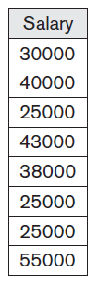
TABLES AS SETS
Query: Retrieve the salary of every employee.
      SELECT ALL Salary
      FROM EMPLOYEE;
Output:
SQL does not automatically eliminate duplicate tuples in query results

Slide 34
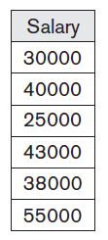

TABLES AS SETS (CONT.)
Query: Retrieve all distinct salary values.
    SELECT DISTINCT Salary
    FROM EMPLOYEE;
Output:
  Allows only distinct tuples in the result

Slide 35
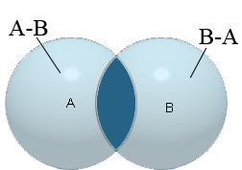
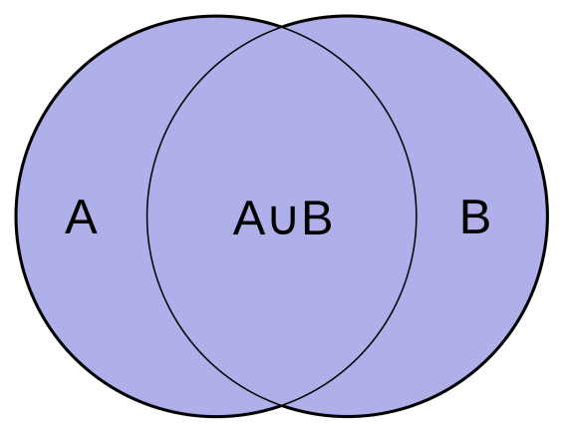
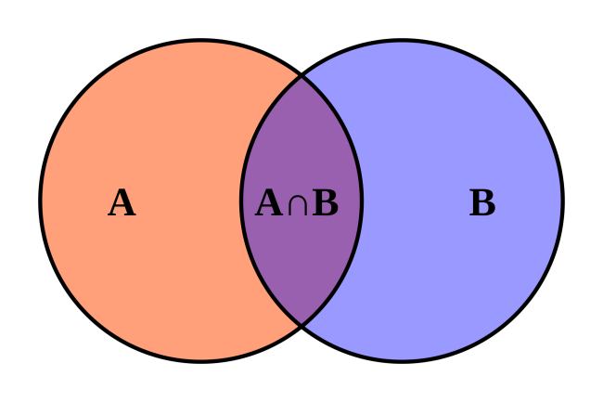
TABLES AS SETS (CONT.)
Applicable to union-compatible relations i.e. the two relations should have the same attributes and in the same order in both relations.
SET OPERATIONS
Operation | Relational Algebra | SQL
Difference | - | EXCEPT
Union | U | UNION
Intersection | ∩ | INTERSECT

Slide 36
EXAMPLE
Query: Make a list of all project numbers for projects that involve an employee whose last name is ‘Smith’, either as a worker or as a manager of the department that controls the project.
    (SELECT DISTINCT Pnumber
    FROM PROJECT, DEPARTMENT, EMPLOYEE
    WHERE Dnum=Dnumber AND Mgr_ssn=Ssn AND Lname=‘Smith’ )
    UNION
    ( SELECT DISTINCT Pnumber
    FROM PROJECT, WORKS_ON, EMPLOYEE
    WHERE Pnumber=Pno AND Essn=Ssn AND Lname=‘Smith’ );
Output:
Pnumber
1
2

Slide 37

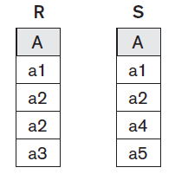


TABLES AS SETS (CONT.)
Corresponding multiset operations: UNION ALL, EXCEPT ALL, INTERSECT ALL)
Multiset Operations: duplicates are not eliminated
Example:
Relations R UNION ALL S R EXCEPT ALL S R INTERSECT ALL S

Slide 38

SUBSTRING PATTERN MATCHING
Query: Retrieve all employees whose address is in Houston, Texas.
    SELECT Fname, Lname
    FROM EMPLOYEE
    WHERE Address LIKE ‘%Houston,TX%’;
Output:
Used for string pattern matching
replaces an arbitrary number of zero or more characters
Fname | Lname
John | Smith
Franklin | Wong
Joyce | English
Ahmad | Jabbar
James | Borg

Slide 39
SUBSTRING PATTERN MATCHING (CONT.)
Query: Find all employees who were born during the 1950s.
      SELECT Fname, Lname
      FROM EMPLOYEE
      WHERE Bdate LIKE ‘_ _ 5 _ _ _ _ _ _ _’;
Output:
Used for string pattern matching
replaces a single character
Fname | Lname
Franklin | Wong

Slide 40

ARITHMETIC OPERATORS
Query: Show the resulting salaries if every employee working on the ‘ProductX’ project is given a 10 percent raise.
    SELECT E.Fname, E.Lname, 1.1 * E.Salary AS Increased_sal
    FROM EMPLOYEE AS E, WORKS_ON AS W, PROJECT AS P
    WHERE E.Ssn=W.Essn AND W.Pno=P.Pnumber AND P.Pname=‘ProductX’;
Output:
Fname | Lname | Increased_sal
John | Smith | 33000
Joyce | English | 27500

Slide 41
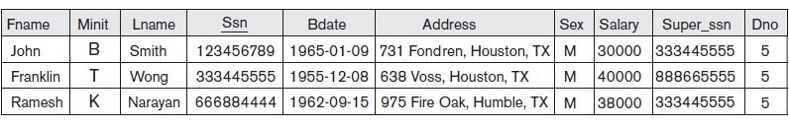
ARITHMETIC OPERATORS (CONT.)
Query: Retrieve all employees in department 5 whose salary is between $30,000 and $40,000.
    SELECT *
    FROM EMPLOYEE
    WHERE (Salary BETWEEN 30000 AND 40000) AND Dno = 5;
Output:
((Salary >= 30000) AND (Salary <= 40000))

Slide 42
ORDERING OF QUERY RESULTS
Query: Retrieve a list of employees and the projects they are working on, ordered by department and, within each department, ordered alphabetically by last name, then first name.
  SELECT D.Dname, E.Lname, E.Fname, P.Pname
  FROM DEPARTMENT D, EMPLOYEE E, WORKS_ON W, PROJECT P
  WHERE D.Dnumber=E.Dno AND E.Ssn=W.Essn AND W.Pno= P.Pnumber
  ORDER BY D.Dname, E.Lname, E.Fname;
Default order is ascending.
First order on Dname, if Dname same then on Lname, if Lname same then on Fname
  Use ASC or DESC to change default order: ORDER BY D.Dname DESC, E.Lname ASC, E.Fname ASC

Slide 43
ORDERING OF QUERY RESULTS (CONT.)
Dname | Lname | Fname | Pname
Administration | Jabbar | Ahmad | Computerization
Administration | Jabbar | Ahmad | NewBenefits
Administration | Wallace | Jennifer | NewBenefits
Administration | Wallace | Jennifer | Reorganization
Administration | Zelaya | Alicia | Computerization
Administration | Zelaya | Alicia | NewBenefits
Headquarters | Borg | James | Reorganization
Research | English | Joyce | ProductX
Research | English | Joyce | ProductY
Research | Narayan | Ramesh | ProductZ
Research | Smith | John | ProductX
Research | Smith | John | ProductY
Research | Wong | Franklin | ProductY
Research | Wong | Franklin | ProductZ
Research | Wong | Franklin | Computerization
Research | Wong | Franklin | Reorganization
Output:

Slide 44
SUMMARY
        SELECT <attribute list>
        FROM <table list>
        [ WHERE <condition> ]
        [ ORDER BY <attribute list> ];
OPTIONAL

Slide 45
THE DELETE COMMAND
DELETE FROM EMPLOYEE
WHERE Lname=‘Brown’;
DELETE FROM EMPLOYEE
WHERE Ssn=‘123456789’;
DELETE FROM EMPLOYEE;
To specify the tuples to be deleted
missing WHERE clause
specifies that all tuples in the relation are to be deleted. The table remains in the database as an empty table.

Slide 46
THE UPDATE COMMAND
Modify attribute values of one or more selected tuples
UPDATE PROJECT
  SET Plocation = ‘Bellaire’, Dnum = 5
  WHERE Pnumber=10;
UPDATE EMPLOYEE
  SET Salary = Salary * 1.1
  WHERE Dno = 5;
To specify attributes to be modified and new values

Slide 47
THANKS!!

